Slide 1
Lecture 5 3D Modeling and Animation Assoc.Prof.Dr. Hossam Mahmoud Moftah Associate professor – Faculty of computers and artificial intelligence– Beni-Suef University

Slide 2
Chapter 4 Exploring Animation, Story, and Pre-visualization
Adapted from Andy Beane: 3D animation essentials 2012 by John Wiley & Sons, Inc.,

Slide 3
Building a good story
Story Arc (layers)
Layer 1 : has 3 elements
Beginning,
Middle,
End
Adapted from Andy Beane: 3D animation essentials 2012 by John Wiley & Sons, Inc.,

Slide 4
Building a good story
Story Arc (layers)
Layer 2
The tension or excitement level
A film, for instance, typically starts with an exciting opening.
Then the film has a small fall in tension that then builds up again in multiple crises, each one bigger than the last
Finally, tension falls again to allow the audience to come down at the end.
Adapted from Andy Beane: 3D animation essentials 2012 by John Wiley & Sons, Inc.,

Slide 5
Building a good story
Good story elements :
Characters
A goal
Conflict
Adapted from Andy Beane: 3D animation essentials 2012 by John Wiley & Sons, Inc.,

Slide 6
Building a good story
Characters :
Characters definition : Characters are used to show who the story is about and whose eyes we see the story through.
Characters forms :
The hero is the main character.
The friend or sidekick is a support character for the main character to learn from or lean on.
The villain is the opposite of the hero and is trying to stop or destroy the hero.
The challenger is a person, creature, or event the hero must overcome.
The trickster tries t o trick or outwit the hero.
The shape-shifter is not who he seems to be when first introduced.
Adapted from Andy Beane: 3D animation essentials 2012 by John Wiley & Sons, Inc.,

Slide 7
Building a good story
Goal:
Goal definition : The goal can be anything the main character wants and is willing to overcome obstacles for.
The goal cannot be as simple
Adapted from Andy Beane: 3D animation essentials 2012 by John Wiley & Sons, Inc.,

Slide 8
Building a good story
Conflict :
Conflict definition : There must be a conflict as the character pursues the goal, or it would not be an interesting story.
Conflict example:
If your main character wants to find the treasure from a map, and could just follow the map and dig up the treasure, that would be boring to watch.
But if the hero had to outsmart traps, fight monsters, and almost die in the process, those conflicts make the story worth watching. All conflict adds drama and makes a better story.
Adapted from Andy Beane: 3D animation essentials 2012 by John Wiley & Sons, Inc.,

Slide 9
Building a good story
Conflict :
Conflict types:
Man vs. Man
Man vs. Nature
Man vs. Society
Man vs. Himself
Adapted from Andy Beane: 3D animation essentials 2012 by John Wiley & Sons, Inc.,

Slide 10
Building a good story
The Hero’s Journey
This hero’s journey has 17 stages from which the story emerges.
Stages will not be discussed now
Adapted from Andy Beane: 3D animation essentials 2012 by John Wiley & Sons, Inc.,

Slide 11
Building a good story
Storytelling Principles
Use Empathy,
Empathy is the ability to understand another’s feelings
The Rule of Three
words, things, or situations are funnier or remembered better if done in groups of threes.
Show, Don’t Tell
You do not merely tell the audience what is going to happen or how a character is feeling; you want to show it to them.
Adapted from Andy Beane: 3D animation essentials 2012 by John Wiley & Sons, Inc.,

Slide 12
Using Pre-visualization Techniques
Pre-visualization definition: is a technique used in film and television that utilizes 3D animation to plan the pacing, cuts, and camera angles of a sequence.
Main areas of pre-visualization techniques:
Basic shot framing
Camera movements
Editing
Adapted from Andy Beane: 3D animation essentials 2012 by John Wiley & Sons, Inc.,

Slide 13
Using Pre-visualization Techniques
Basic shot framing: The audience can see only what you show them.
Consider the following when framing a shot:
Aspect ratio
Basic shot types
Basic composition rules
Directing the viewer’s eye
Adapted from Andy Beane: 3D animation essentials 2012 by John Wiley & Sons, Inc.,

Slide 14
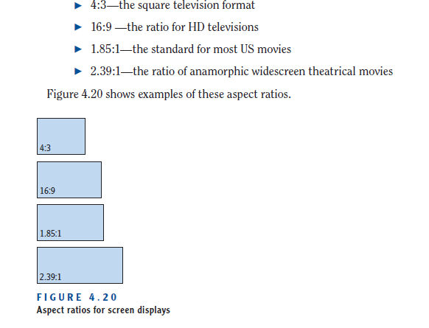
Using Pre-visualization Techniques
Aspect ratio : The aspect ratio is the height-to-width ratio of the screen size you are working with.
Adapted from Andy Beane: 3D animation essentials 2012 by John Wiley & Sons, Inc.,

Slide 15
Using Pre-visualization Techniques
Basic shot types:
Extreme Wide Shot (or establishing shot)
Wide Shot
Medium Shot
Close-up
POV
Over the Shoulder
Adapted from Andy Beane: 3D animation essentials 2012 by John Wiley & Sons, Inc.,

Slide 16
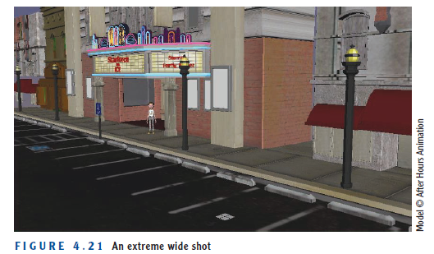
Using Pre-visualization Techniques
Basic shot types:
Extreme Wide Shot (or establishing shot)
This type of shot helps viewers know where they are and the positions of objects and figures.
Adapted from Andy Beane: 3D animation essentials 2012 by John Wiley & Sons, Inc.,

Slide 17
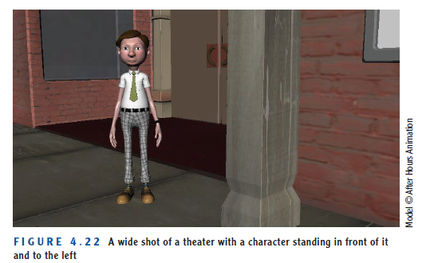
Using Pre-visualization Techniques
Basic shot types:
2. Wide Shot
Also known as a long shot, this type fills nearly the full vertical height of the screen with the subject.
Adapted from Andy Beane: 3D animation essentials 2012 by John Wiley & Sons, Inc.,

Slide 18
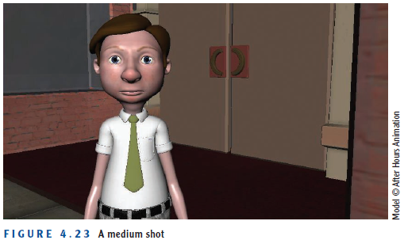
Using Pre-visualization Techniques
Basic shot types:
3. Medium Shot
A medium shot, or mid shot, shows the main subject in more detail than the wide shot. If the subject is a character, the character is typically framed from the waist to the head.
Adapted from Andy Beane: 3D animation essentials 2012 by John Wiley & Sons, Inc.,

Slide 19
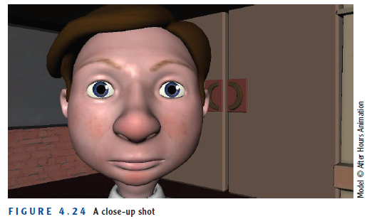
Using Pre-visualization Techniques
Basic shot types:
4. Close-up
In this shot, one subject takes up the entire frame. If a character is the subject and we are shooting a close-up of the character’s head, the chin will be just above the bottom of the screen and the top of the head will be just below the top of the screen .
Adapted from Andy Beane: 3D animation essentials 2012 by John Wiley & Sons, Inc.,

Slide 20
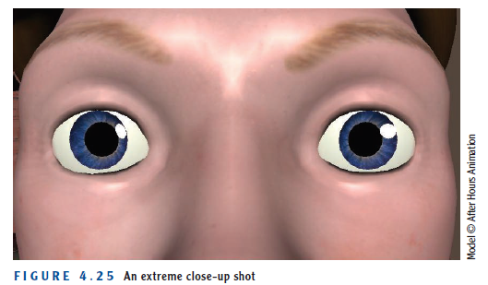
Using Pre-visualization Techniques
Basic shot types:
4. Extreme Close-up
This shot focuses on a small detail of the subject. For example, Figure 4.25 shows an extreme close-up of a character’s eyes.
Adapted from Andy Beane: 3D animation essentials 2012 by John Wiley & Sons, Inc.,

Slide 21
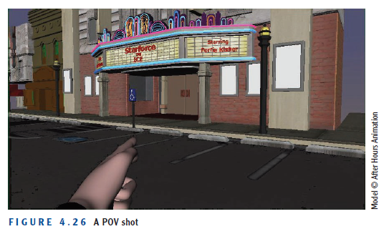
Using Pre-visualization Techniques
Basic shot types:
5. POV
A point-of-view (POV) shot illustrates a character’s point of view.
Adapted from Andy Beane: 3D animation essentials 2012 by John Wiley & Sons, Inc.,

Slide 22
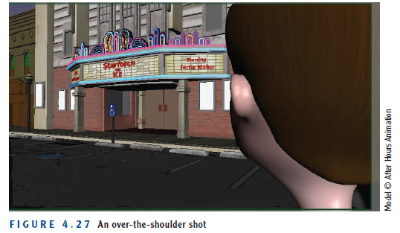
Using Pre-visualization Techniques
Basic shot types:
6. Over the Shoulder
This shot frames the back of one character’s head on one side of the screen, and another character’s face or the environment on the other side. This type of shot is used all the time in television, film, and even video games.
Adapted from Andy Beane: 3D animation essentials 2012 by John Wiley & Sons, Inc.,

Slide 23
Using Pre-visualization Techniques
Basic Composition Rules
Golden Ratio
Rule of Thirds
Head Room and Nose Room
Adapted from Andy Beane: 3D animation essentials 2012 by John Wiley & Sons, Inc.,

Slide 24
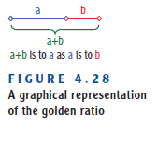


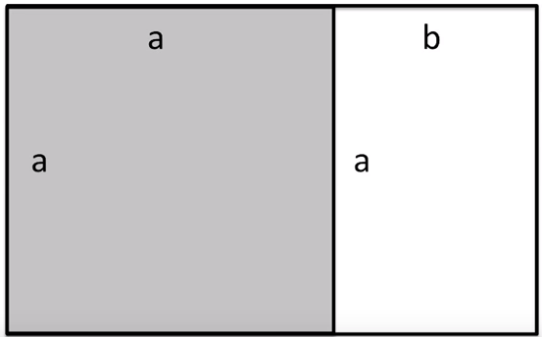
Using Pre-visualization Techniques
Basic Composition Rules :
Golden Ratio
The golden ratio describes a spatial relationship between two quantities.
if you divide a line into two parts, and the longer part divided by the shorter part is the same as the whole length divided by the longer part, you have created the golden ratio.
a+b
a
a
=
b
=
=
1.618
Adapted from Andy Beane: 3D animation essentials 2012 by John Wiley & Sons, Inc.,

Slide 25
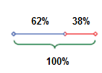
Using Pre-visualization Techniques
Basic Composition Rules :
Golden Ratio
This ratio is used in math, art design, financial markets, and nature. Figure 4.29 shows the golden ratio’s presence in a chambered nautilus.
About 5:3
Adapted from Andy Beane: 3D animation essentials 2012 by John Wiley & Sons, Inc.,

Slide 26
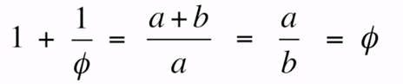
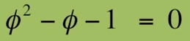
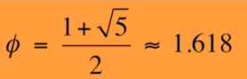
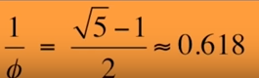
Using Pre-visualization Techniques
Basic Composition Rules :
Golden Ratio
Adapted from Tipping Point Math youtube channel-
Adapted from Andy Beane: 3D animation essentials 2012 by John Wiley & Sons, Inc.,

Slide 27
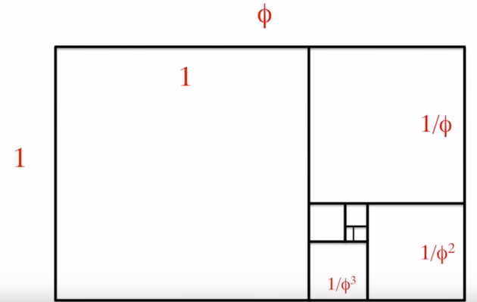
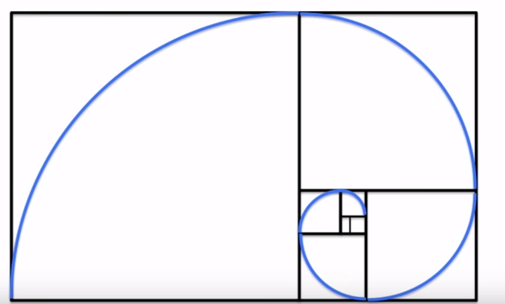
Using Pre-visualization Techniques
Basic Composition Rules :
Golden Ratio
Adapted from Tipping Point Math youtube channel-
Adapted from Andy Beane: 3D animation essentials 2012 by John Wiley & Sons, Inc.,

Slide 28
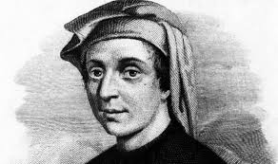
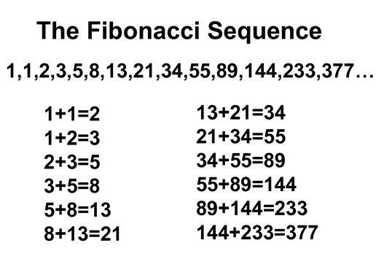
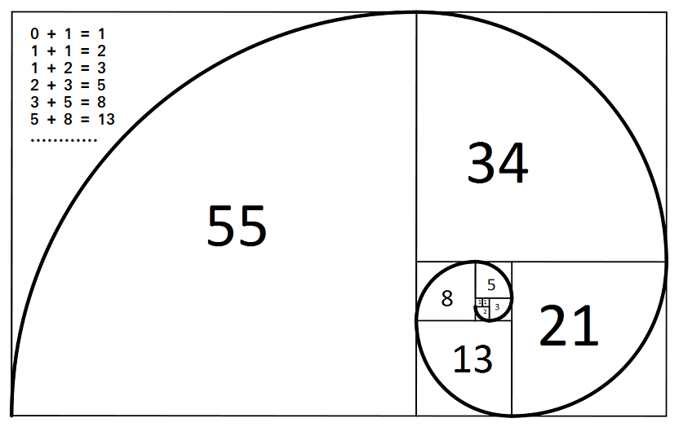
Using Pre-visualization Techniques
Basic Composition Rules :
Golden Ratio
Fibonacci sequence
Adapted from Tipping Point Math youtube channel-
Adapted from Andy Beane: 3D animation essentials 2012 by John Wiley & Sons, Inc.,

Slide 29
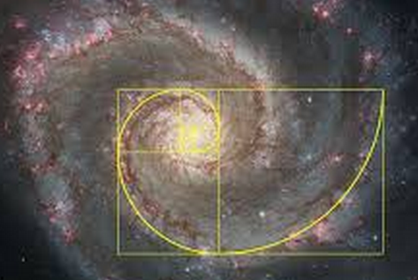
Using Pre-visualization Techniques
Basic Composition Rules :
Golden Ratio
Fibonacci sequence
Adapted from Tipping Point Math youtube channel-
Adapted from Andy Beane: 3D animation essentials 2012 by John Wiley & Sons, Inc.,

Slide 30
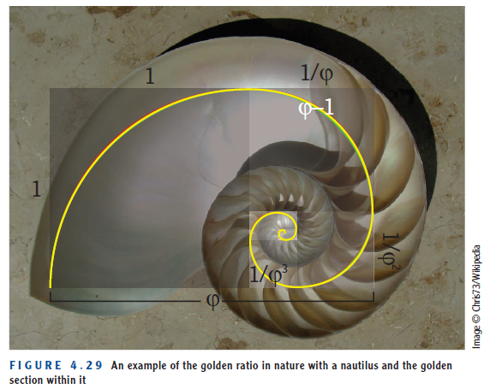
Using Pre-visualization Techniques
Basic Composition Rules :
Golden Ratio examples
Adapted from Andy Beane: 3D animation essentials 2012 by John Wiley & Sons, Inc.,

Slide 31
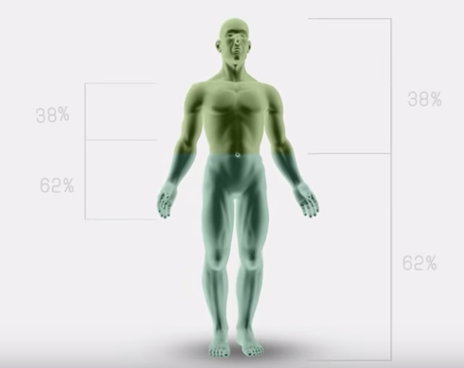
Using Pre-visualization Techniques
Basic Composition Rules :
Golden Ratio examples
Adapted from المقررات المفتوحةYouTube channel-
Adapted from Andy Beane: 3D animation essentials 2012 by John Wiley & Sons, Inc.,

Slide 32
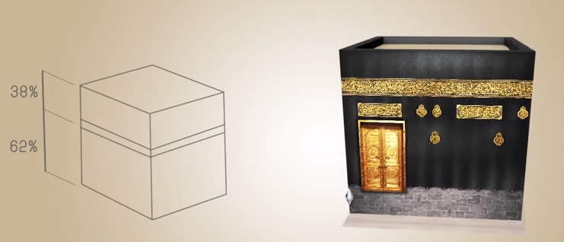
Using Pre-visualization Techniques
Basic Composition Rules :
Golden Ratio examples
Adapted from المقررات المفتوحةyoutube channel-
Adapted from Andy Beane: 3D animation essentials 2012 by John Wiley & Sons, Inc.,

Slide 33
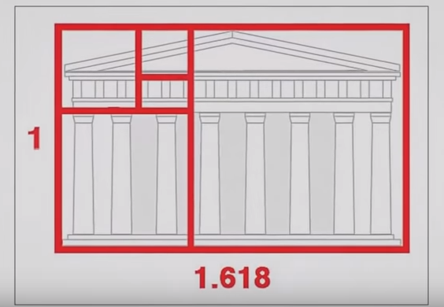
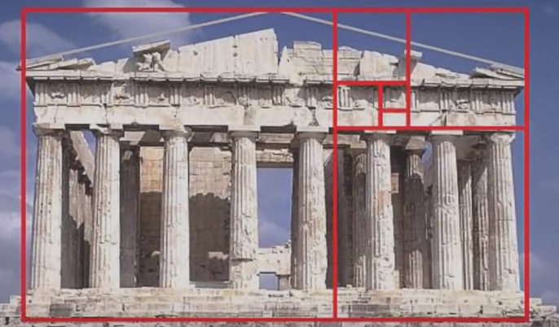
Using Pre-visualization Techniques
Basic Composition Rules :
Golden Ratio examples
Adapted from Tipping Point Math YouTube channel-
Adapted from Andy Beane: 3D animation essentials 2012 by John Wiley & Sons, Inc.,

Slide 34
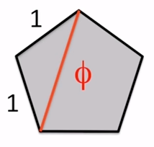
Using Pre-visualization Techniques
Basic Composition Rules :
Golden Ratio examples
Adapted from Tipping Point Math YouTube channel-
Adapted from Andy Beane: 3D animation essentials 2012 by John Wiley & Sons, Inc.,

Slide 35
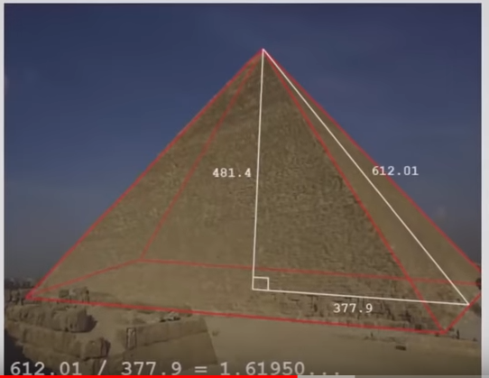
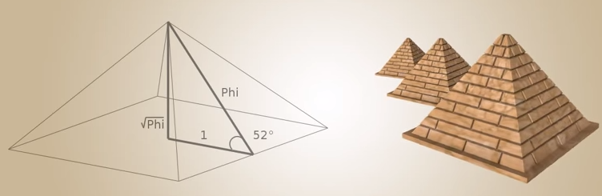
Using Pre-visualization Techniques
Basic Composition Rules :
Golden Ratio examples
Adapted from المقررات المفتوحةYouTube channel-
Adapted from Andy Beane: 3D animation essentials 2012 by John Wiley & Sons, Inc.,

Slide 36
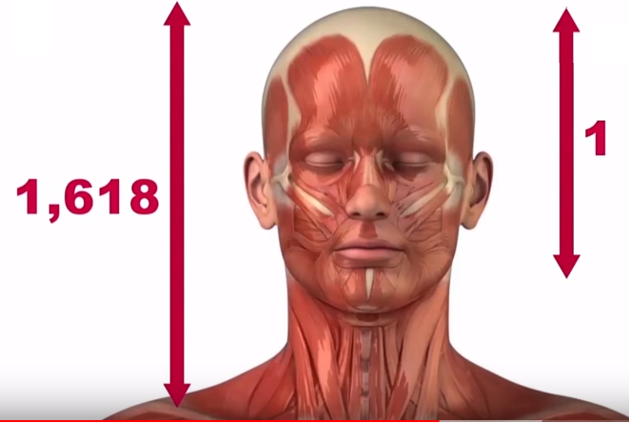
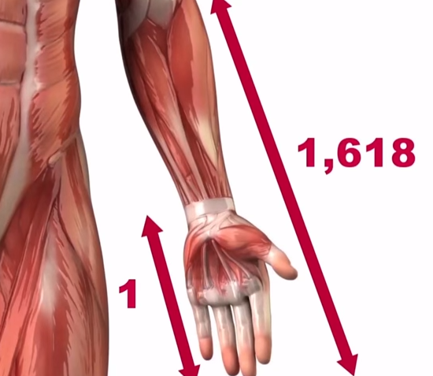
Using Pre-visualization Techniques
Basic Composition Rules :
Golden Ratio examples
Adapted from VISION YouTube channel-
Adapted from Andy Beane: 3D animation essentials 2012 by John Wiley & Sons, Inc.,

Slide 37
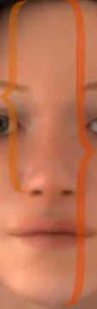
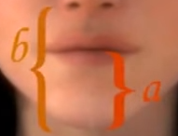
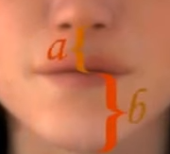
Using Pre-visualization Techniques
Basic Composition Rules :
Golden Ratio examples
a
b
Adapted from Mohammad Malik YouTube channel-
Adapted from Andy Beane: 3D animation essentials 2012 by John Wiley & Sons, Inc.,

Slide 38
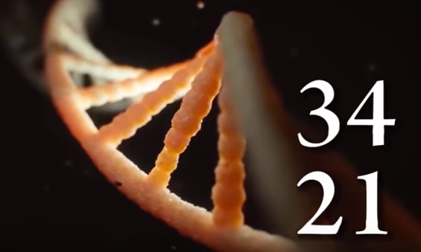
Using Pre-visualization Techniques
Basic Composition Rules :
Golden Ratio examples
DNA molecules consist of a pair of vertically intertwined spirals 34 inches long and 21 inches wide.
Adapted from VISION YouTube channel-
Adapted from Andy Beane: 3D animation essentials 2012 by John Wiley & Sons, Inc.,

Slide 39
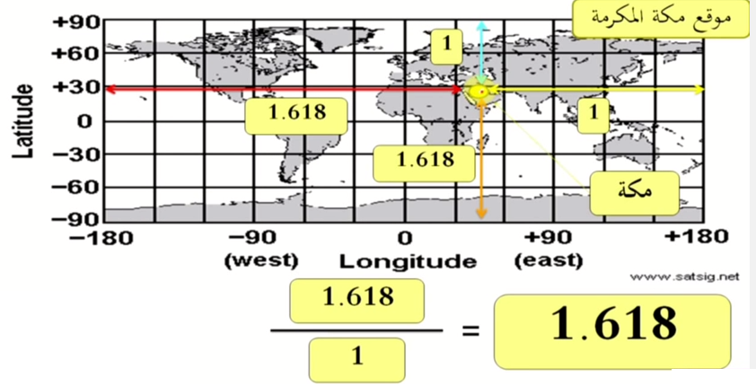
Using Pre-visualization Techniques
Basic Composition Rules :
Golden Ratio examples
Adapted from zaidg YouTube channel-
Adapted from Andy Beane: 3D animation essentials 2012 by John Wiley & Sons, Inc.,

Slide 40
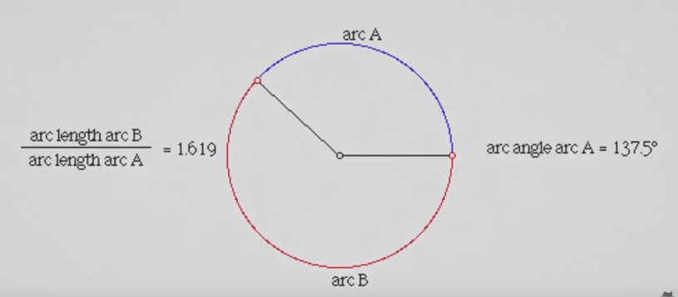
Using Pre-visualization Techniques
Basic Composition Rules :
Golden Ratio examples
Adapted from أسرارYouTube channel-
Adapted from Andy Beane: 3D animation essentials 2012 by John Wiley & Sons, Inc.,

Slide 41

Using Pre-visualization Techniques
Basic Composition Rules :
Golden Ratio examples
Arc angle =137.5
Adapted from THINK SNACK YouTube channel-
Adapted from Andy Beane: 3D animation essentials 2012 by John Wiley & Sons, Inc.,

Slide 42
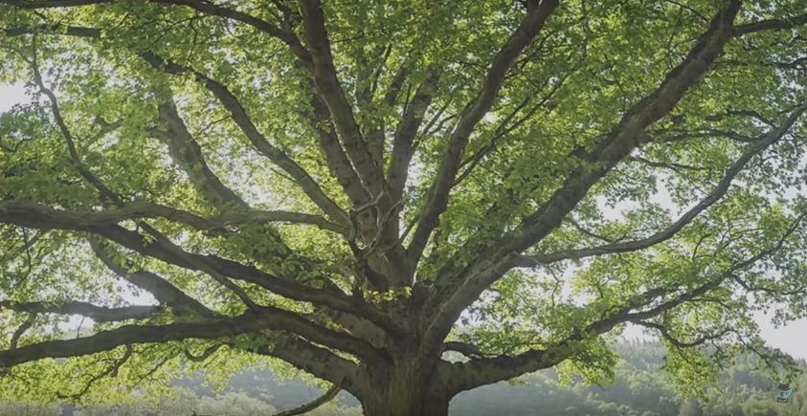
Using Pre-visualization Techniques
Basic Composition Rules :
Golden Ratio examples
Arc angle =137.5
Adapted from أسرارYouTube channel-
Adapted from Andy Beane: 3D animation essentials 2012 by John Wiley & Sons, Inc.,

Slide 43
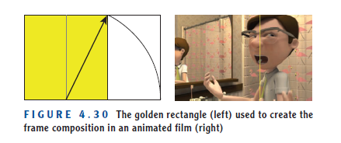
Using Pre-visualization Techniques
Basic Composition Rules :
Golden Ratio examples
Adapted from Andy Beane: 3D animation essentials 2012 by John Wiley & Sons, Inc.,

Slide 44
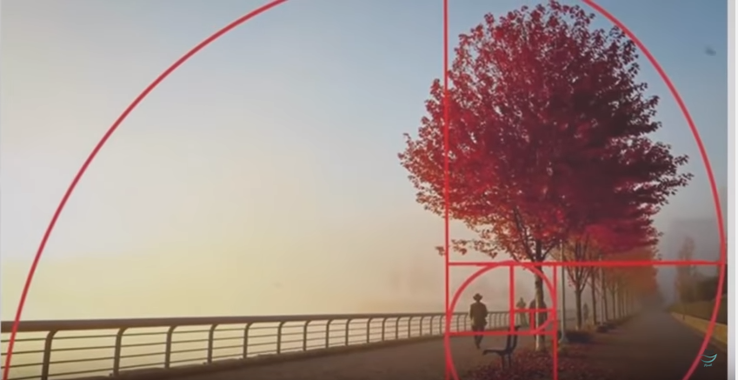
Using Pre-visualization Techniques
Basic Composition Rules :
Golden Ratio examples
Adapted from أسرارYouTube channel-
Adapted from Andy Beane: 3D animation essentials 2012 by John Wiley & Sons, Inc.,

Slide 45
Using Pre-visualization Techniques
Basic Composition Rules :
Rule of Thirds
Imagine a grid dividing your screen into thirds horizontally and vertically. The rule of thirds states that the locations where the lines meet are hot spots for placing your subject.
Adapted from Andy Beane: 3D animation essentials 2012 by John Wiley & Sons, Inc.,

Slide 46
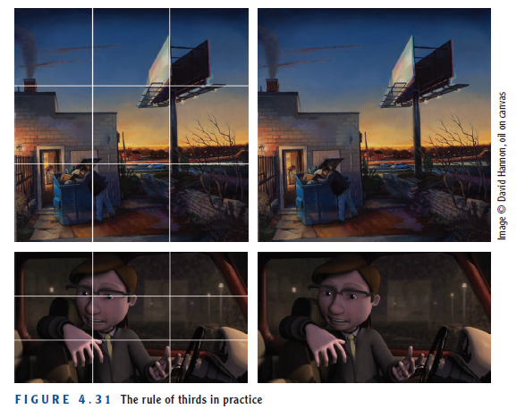
Using Pre-visualization Techniques
Basic Composition Rules :
Rule of Thirds
Adapted from Andy Beane: 3D animation essentials 2012 by John Wiley & Sons, Inc.,

Slide 47
Using Pre-visualization Techniques
Basic Composition Rules :
Head Room and Nose Room
Head room and nose room are methods of framing a shot that include room for the character or object to look offscreen or to move.
Figure 4.32 illustrates nose room. In a medium close-up of a character looking at something in the distance off-camera, you do not want the character’s face in the center of the frame, as in the left image.
Instead you would allow room on the side of the frame for the character to look across, as in the right image.
Adapted from Andy Beane: 3D animation essentials 2012 by John Wiley & Sons, Inc.,

Slide 48
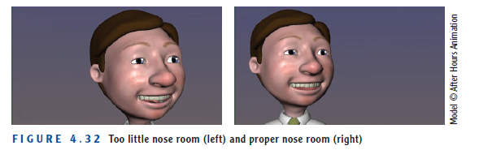
Using Pre-visualization Techniques
Basic Composition Rules :
Nose Room
Adapted from Andy Beane: 3D animation essentials 2012 by John Wiley & Sons, Inc.,

Slide 49
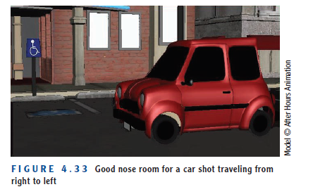
Using Pre-visualization Techniques
Basic Composition Rules :
Nose Room
Adapted from Andy Beane: 3D animation essentials 2012 by John Wiley & Sons, Inc.,

Slide 50
Using Pre-visualization Techniques
Basic Composition Rules :
Head Room
If you are framing the subject in the center as the subject is looking directly into the camera, you should not leave too much head room at the top of the screen.
Excessive head room makes the subject seem weak.
Adapted from Andy Beane: 3D animation essentials 2012 by John Wiley & Sons, Inc.,

Slide 51
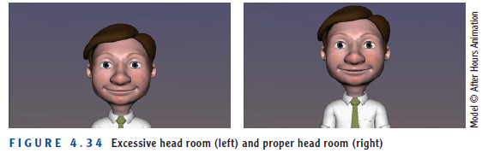
Using Pre-visualization Techniques
Basic Composition Rules :
Head Room
Adapted from Andy Beane: 3D animation essentials 2012 by John Wiley & Sons, Inc.,

Slide 52
Using Pre-visualization Techniques
Directing the Eye
When directing the eye, you lead the eyes of the audience to the area you want them to see.
Directing the Eye methods
Using light and shadows
Color
Create a frame within the frame
Depth of field
Adapted from Andy Beane: 3D animation essentials 2012 by John Wiley & Sons, Inc.,

Slide 53
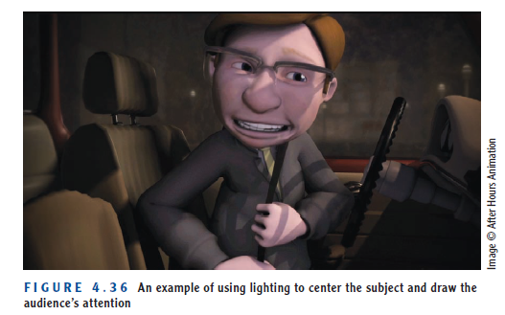
Using Pre-visualization Techniques
Directing the Eye
When directing the eye, you lead the eyes of the audience to the area you want them to see.
You can use light and shadows to make sure you illuminate your subject in a way that enables people to see important details.
Adapted from Andy Beane: 3D animation essentials 2012 by John Wiley & Sons, Inc.,

Slide 54
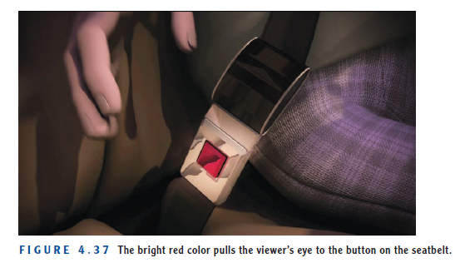
Using Pre-visualization Techniques
Directing the Eye
Color is another way to direct the eye. You can use a vibrant or contrasting color for the subject you want to highlight.
Adapted from Andy Beane: 3D animation essentials 2012 by John Wiley & Sons, Inc.,

Slide 55
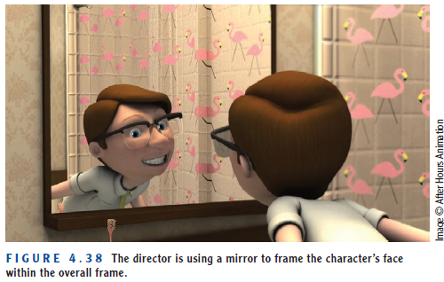
Using Pre-visualization Techniques
Directing the Eye
Another way to lead the eye is to create a frame within the frame of the shot. You can use a window or doorway to frame a character or subject, for instance, as in Figure 4.38.
Adapted from Andy Beane: 3D animation essentials 2012 by John Wiley & Sons, Inc.,

Slide 56
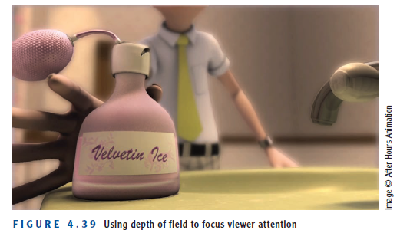
Using Pre-visualization Techniques
Directing the Eye
Depth of field can also be a good way to direct the eye to a certain area of the screen. This optical effect allows a camera lens to focus on one distance at a time. Anything outside the focal distance is out of focus, as in Figure 4.39.
Adapted from Andy Beane: 3D animation essentials 2012 by John Wiley & Sons, Inc.,

Slide 57
The End

